Slide 1
Ocean Currents

Slide 2
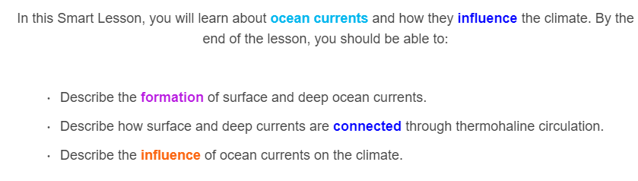
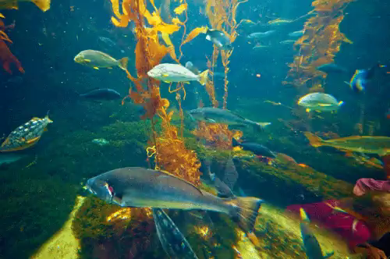

Slide 3
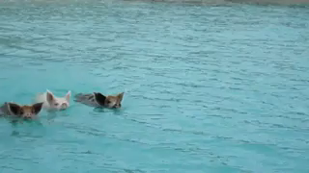
There are two main kinds of ocean currents:
Surface currents
and
Deep currents
As the names suggest, surface currents occur on the surface of the oceans and deep currents occur at the bottom of the oceans.

Slide 4
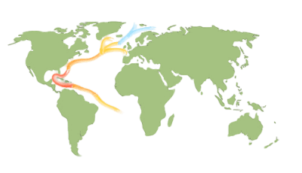
Surface currents are mainly caused by wind and the rotation of the earth.
Surface currents take warm water from the equator to the poles and cold water from the poles to the equator. This ensures that warm climates aren't too hot and cool climates aren't too cold.
One of the most important surface currents is the Gulf Stream, which carries warm water towards Europe.

Slide 5
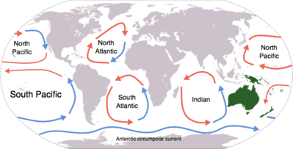
Surface currents initially form due to winds pushing the surface water until it reaches land. Once it reaches land, the water can flow to the left, right or downwards. In the open ocean, the pattern of the current is determined by the rotation of the earth:
Currents in the northern hemisphere rotate clockwise.
Currents in the southern hemisphere rotate anti-clockwise.
The circular patterns formed are called gyres.

Slide 6
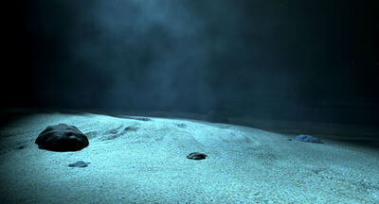
The effects of surface currents are very noticeable, yet they only make up roughly 8% of the ocean's currents!
The rest of the currents are deep currents, which play a smaller, less noticeable role in influencing the climate.

Slide 7
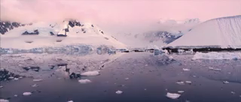
Deep currents form at each pole.
Water cools and sinks to the bottom of the ocean, because cold water is more dense than warm water. As this cold water sinks, it pushes the water underneath it out of the way. This creates slow moving (roughly 1 metre per day) deep ocean currents.
Once it sinks, this water will take hundreds of years to resurface again!

Slide 8
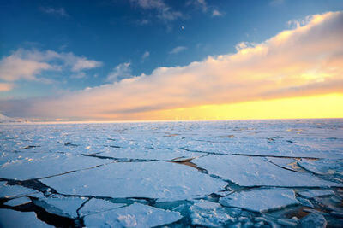
Another factor which causes deep current formation is salinity.
When sea water freezes, the salt inside does not freeze and instead remains in the ocean. This increases the salinity and the density of the surrounding water, which proceeds to sink.

Slide 9
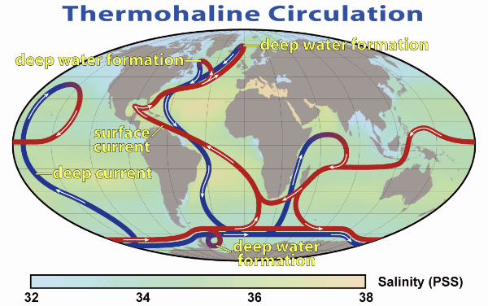
The effect of deep currents on the climate is much more subtle than that of surface currents.
Deep currents travel around the entire globe, making all the oceans a true global system.
If deep ocean water was static, then each gyre would form its own separate system.

Slide 10
As this picture shows, surface currents and deep currents are linked to form a complete cycle, known as thermohaline circulation. Water in this cycle takes around 1600 years to complete a single circuit!
This cycle is what links all the world's oceans; water from the bottom of the Atlantic ocean will, eventually, end up in the top of the Pacific ocean.

